Slide 1
Exploring the spatial organization of synapses in C. elegans
Max Echterling
Gordus Lab
January 18th, 2018

Slide 2
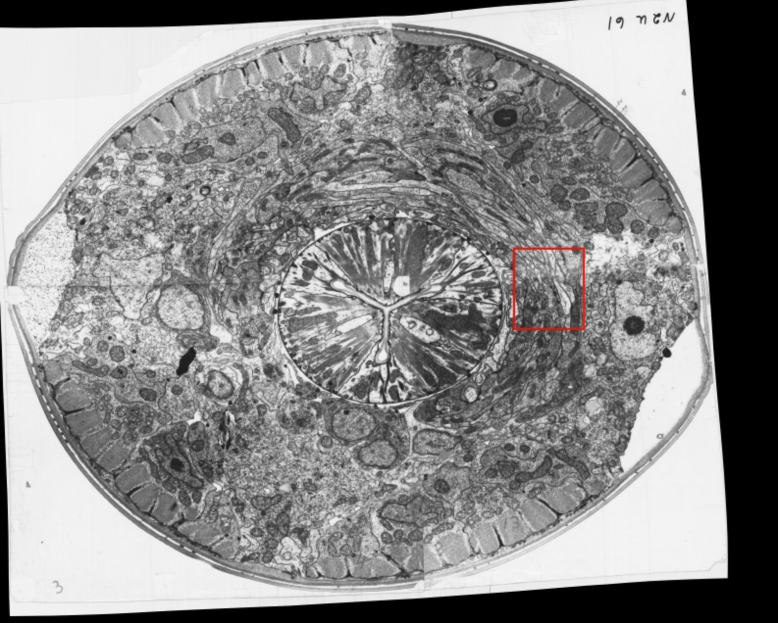
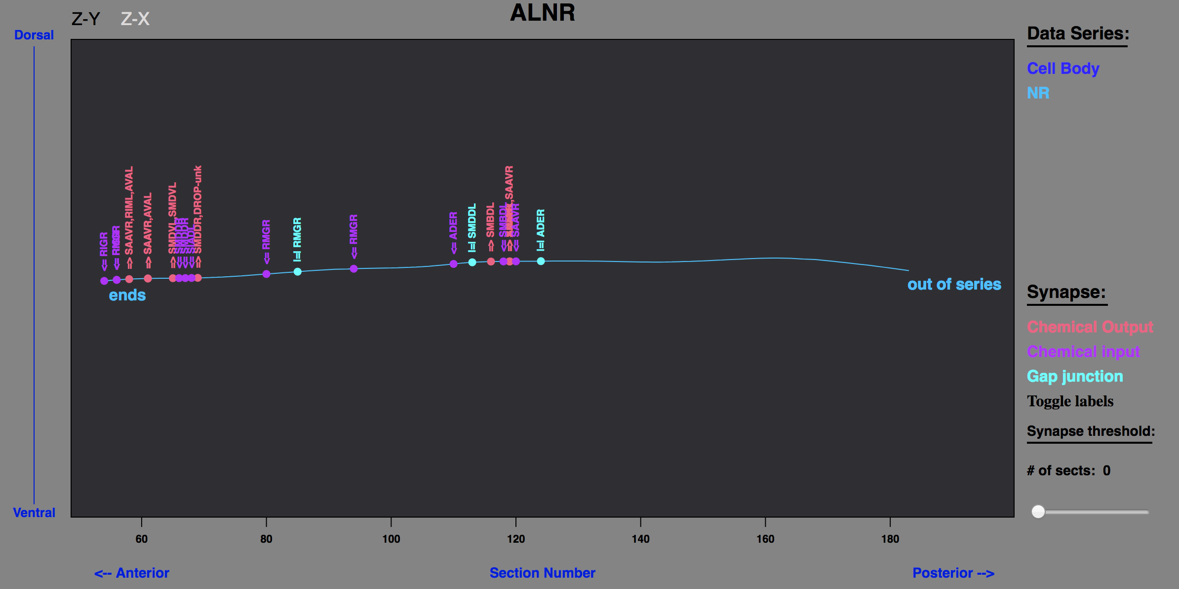
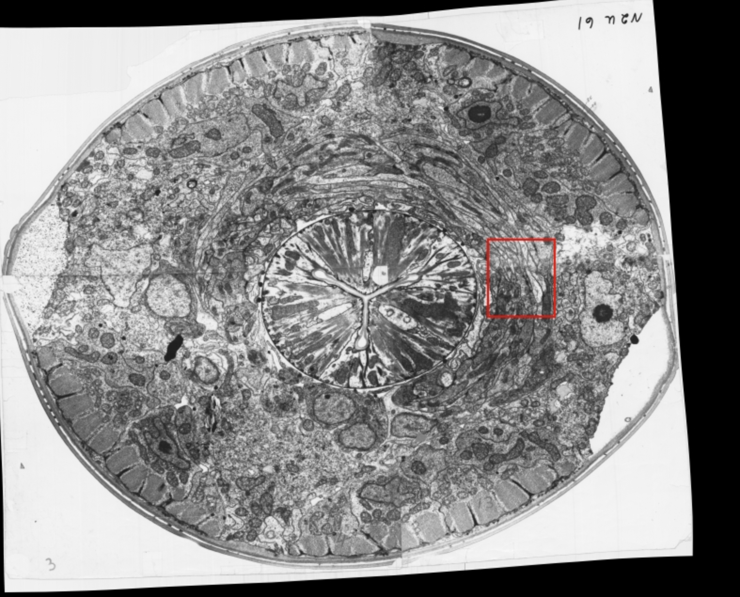
C. elegans: a complete ‘connectome’

Slide 3
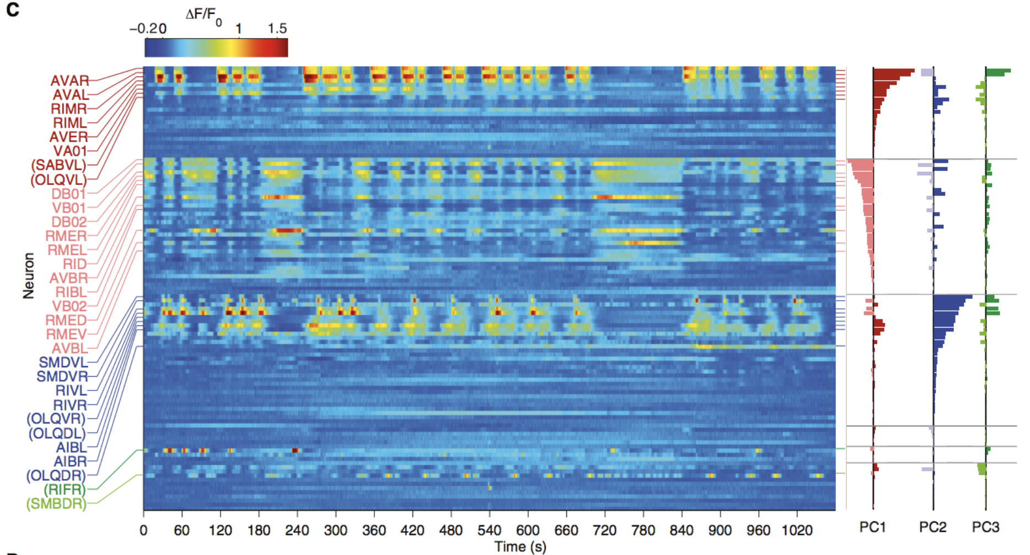
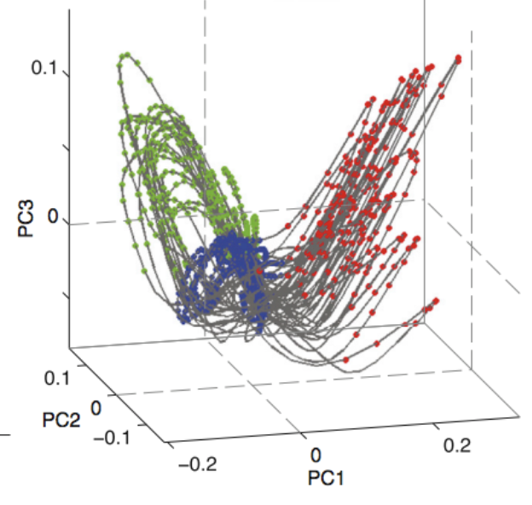
Brain-wide activity occurs on an attractor-like manifold
Kato, S, et. al. Cell 2015

Slide 4
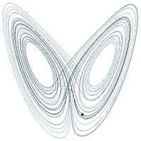
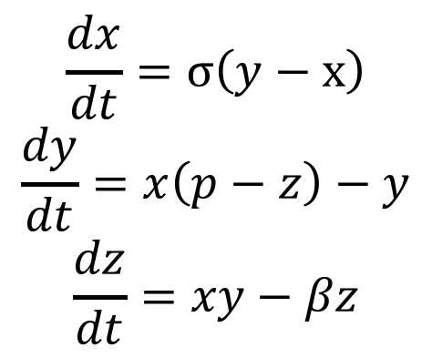
Lorenz System and Chaotic Attractors
$$\frac{dx}{dt}=σ\left(y−x\right)$$
$$\frac{dy}{dt}=x\left(p−z\right)−y$$
$$\frac{dz}{dt}=xy−βz$$
Notes:
2: A chaotic system is unpredictable, yet all solutions lie along a defined manifold. Even though all solutions occur in this space, like the data I showed previously, we can never predict where the solutions will be in time, even though in this case, we know the system COMPLETELY. The reason this is so unpredictable is that these equations are not linear, and therefore not solvable. The instability in the system comes from these multiplicative nonlinearities which destabilize the system. If they were not present, the system would collapse into a predictable state.

Slide 5
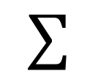
x₁
Linear summation of inputs
w₁
x₂
w₂
y
x₃
w₃
$$∑$$
.
.
.
x_{n}
w_{n}
Notes:
Often times when neuronal networks are modeled, each neuron is modeled as a LINEAR summation. While a system ON AVERAGE may appear this way, it isn’t necessarily true of individual neurons in real life.

Slide 6
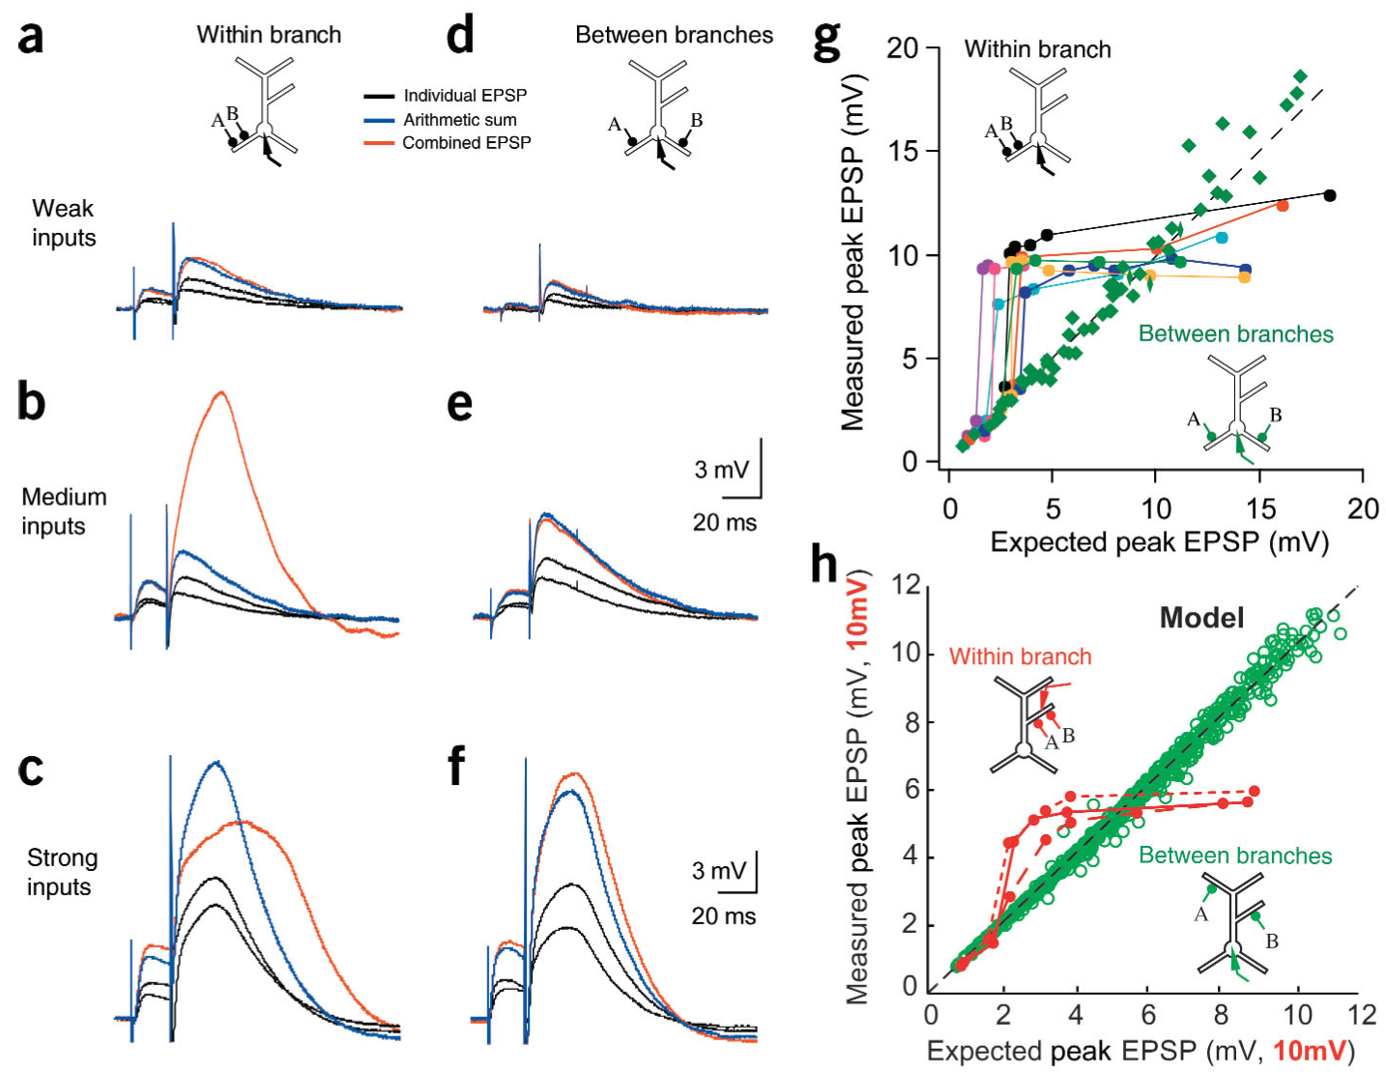
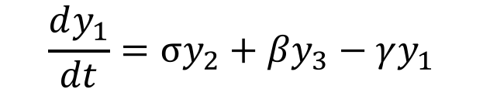
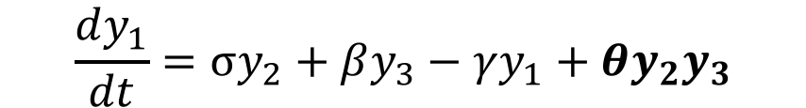
The two-layer neural network model
$$\frac{dy_{1}}{dt}=σy_{2}+βy_{3}−γy_{1}+θy_{2}y_{3}$$
$$\frac{dy_{1}}{dt}=σy_{2}+βy_{3}−γy_{1}$$
Polsky, A, et. al. Nature Neuroscience 2004

Slide 7
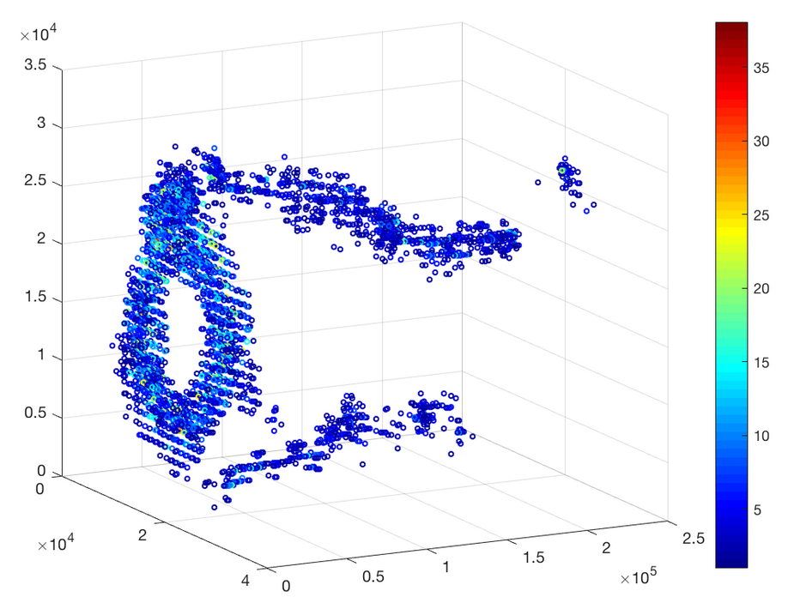
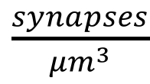
Density of synapses in the connectome
Ventral
$\frac{synapses}{{μm}^{3}}$
Dorsal

Slide 8
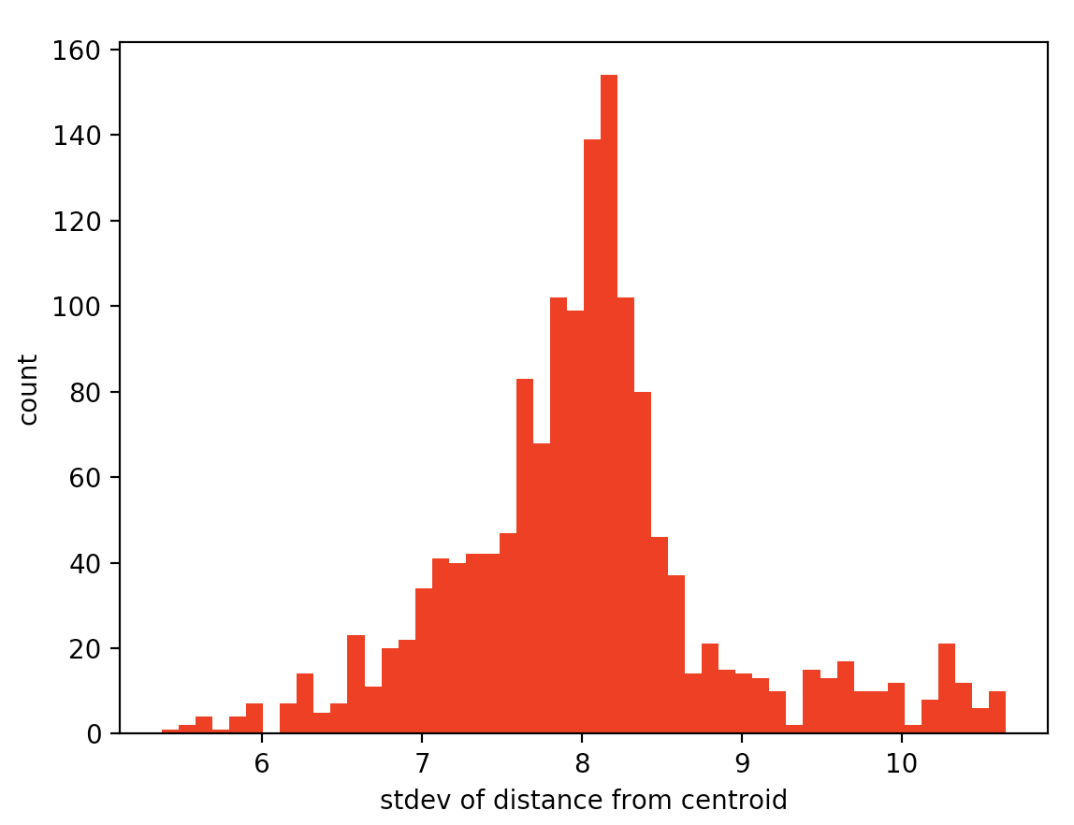
Five-hit synapse deviance
Synapse from high scoring neuron
Synapse from low scoring neuron
count
high
scoring
low
scoring
log₁₀( average distance from centroid )
Top Scoring Neurons
SMDDR
SMDDL
AVEL
RMER
RIMR
RIAL
IL1L

Slide 9
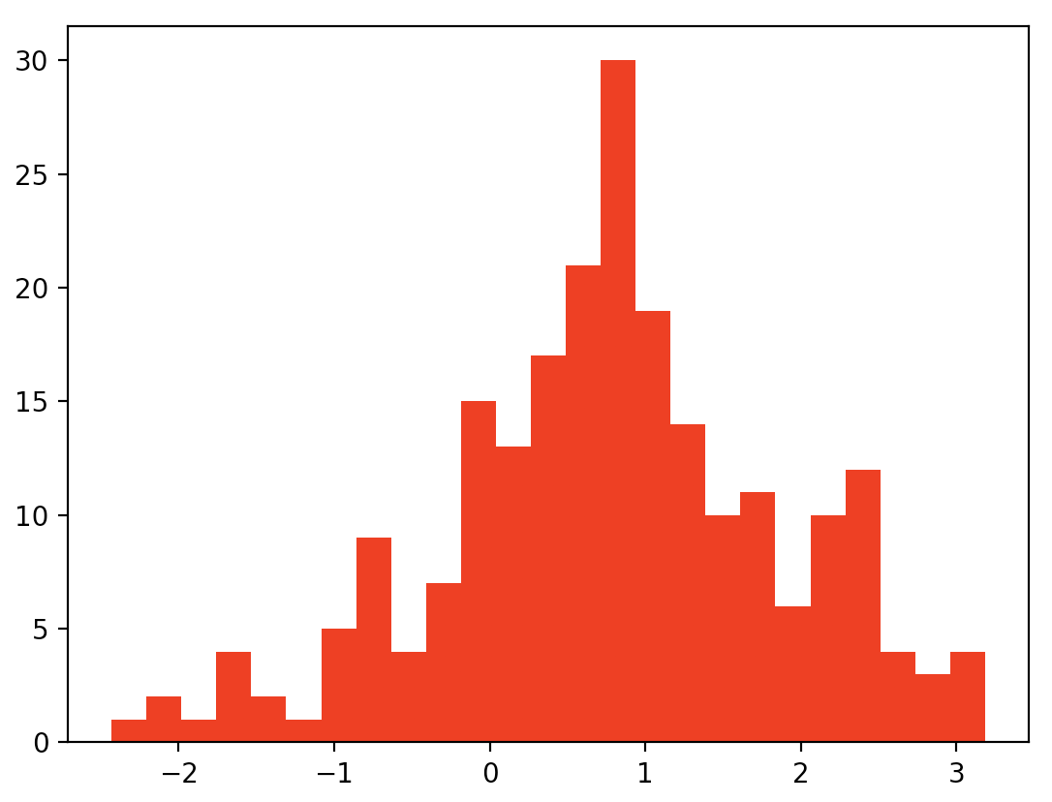
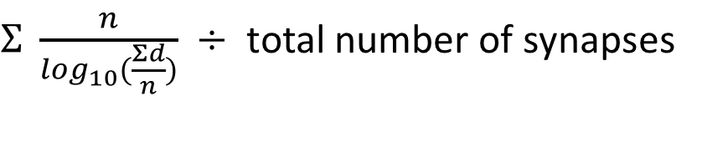
Pairing density by neuron
Scoring Method:
$Σ \frac{n}{\log_{10}⁡(\frac{Σd}{n})}$ $÷$ total number of synapses
low
scoring
high
scoring
counts
high
scoring
log₁₀( density )
Top scoring neurons:
AVAL 24.128351057
AVAR 22.0833974746
RIAL 21.426821049
RIAR 21.3322661083
AVBR 17.590092197
AVER 15.8474284938
AVBL 15.7432483756
AIBR 15.2823714345
AVEL 15.07579348
RMDDL 13.8704503367
AIBL 13.7326298855
low
scoring
Notes:
Move the inputs to dendrites

Slide 10
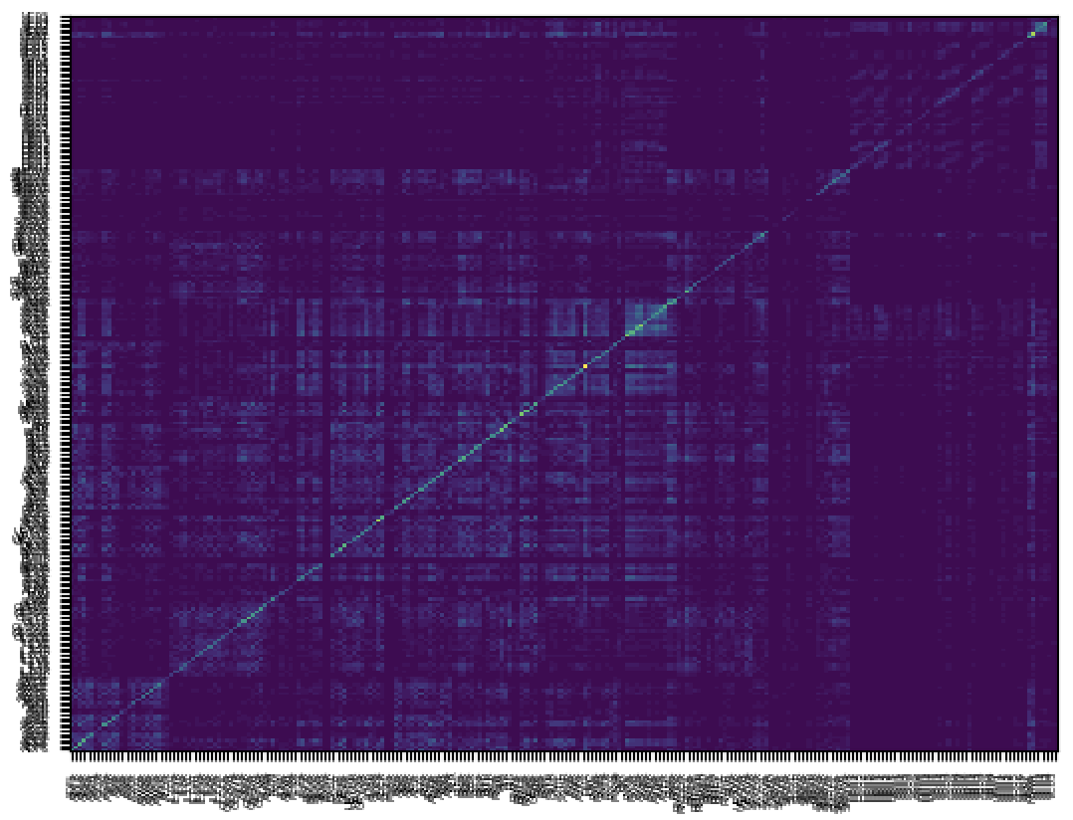
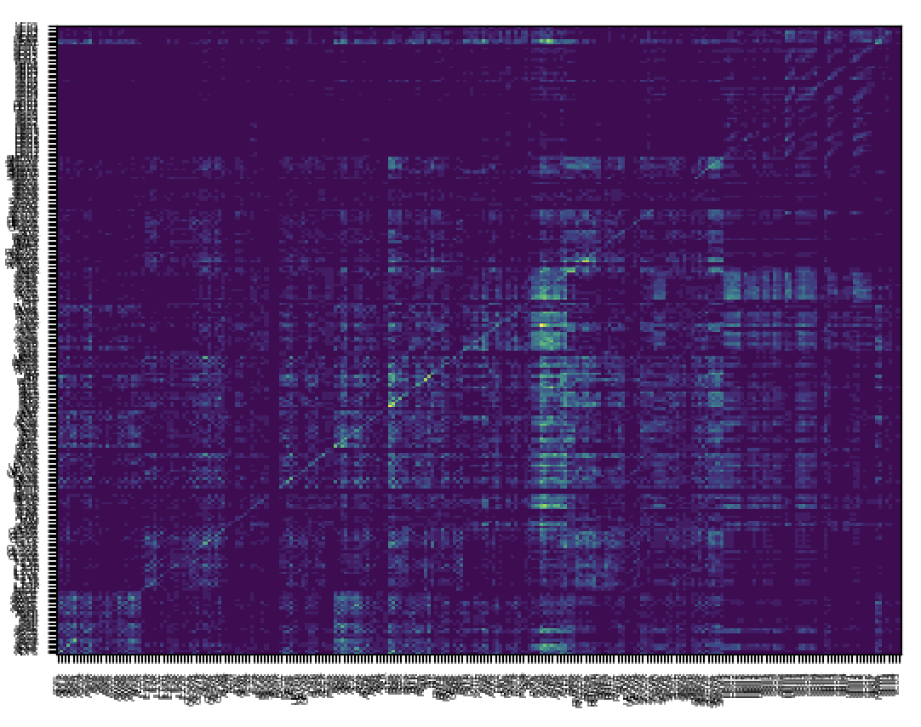
Frequency of synapse pairing between neurons
a
b
a
b
pre/pre
pre/post
pre-synaptic
pre-synaptic
pre-synaptic
post-synaptic

Slide 11
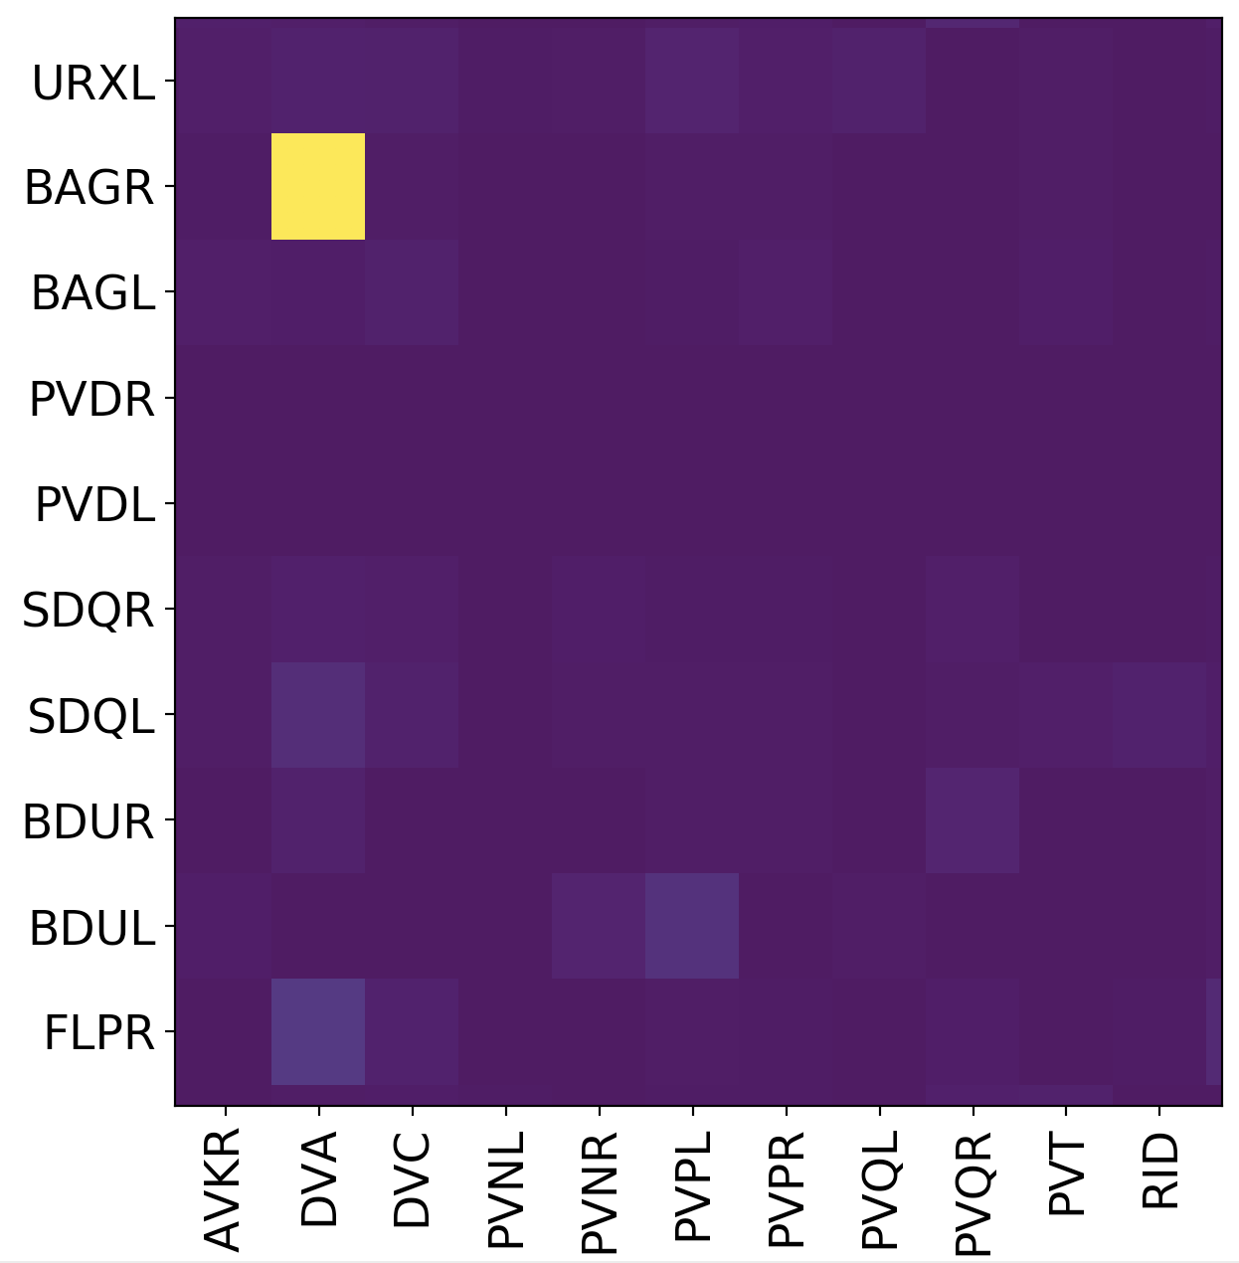
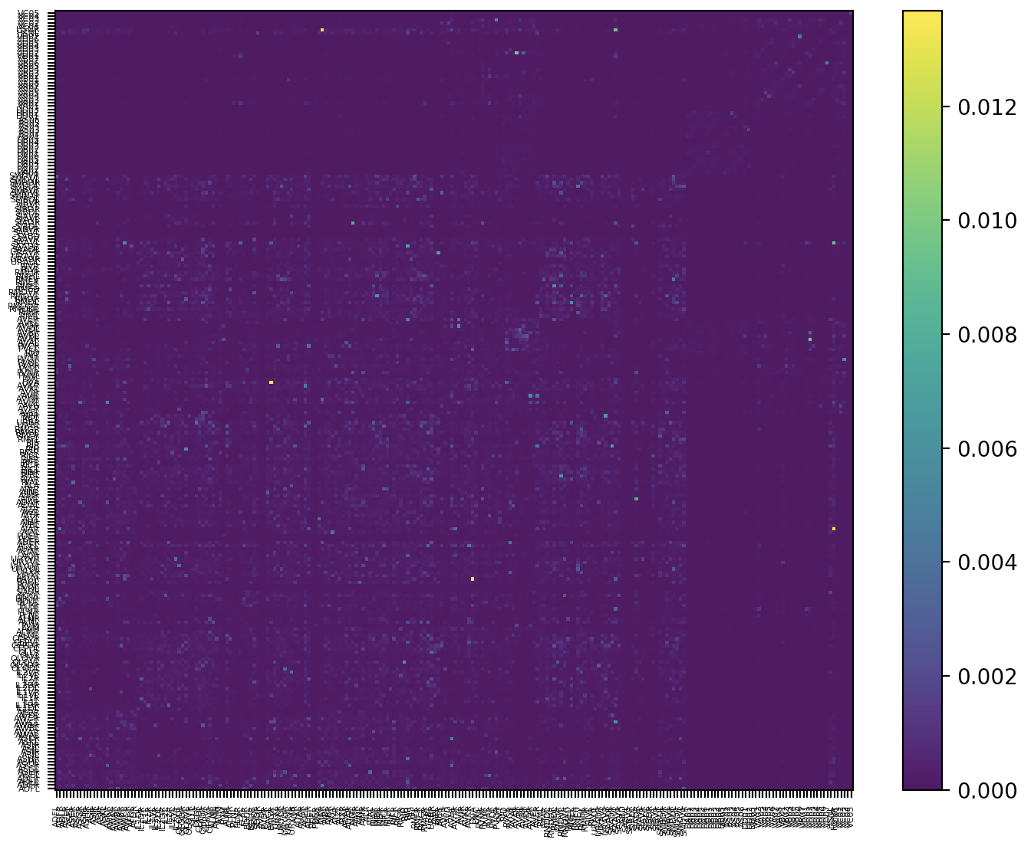
Identifying candidate neurons for hyper-summation experiments
high
proximity
low
proximity

Slide 12
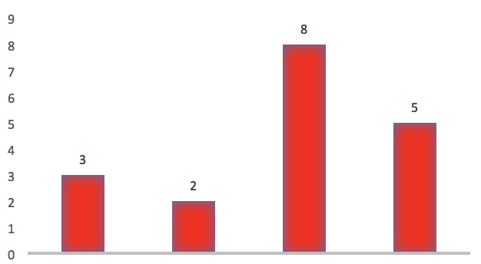
Future Directions: optogenetics with micromirror arrays
micromirror array
ChR2⁺
G-CaMP⁺
G-CaMP fluorescence
ChR2⁺
AU
light source
neuron1
neuron2
combined
Arithmetic sum
Notes:
Two panels adjusted

Slide 13
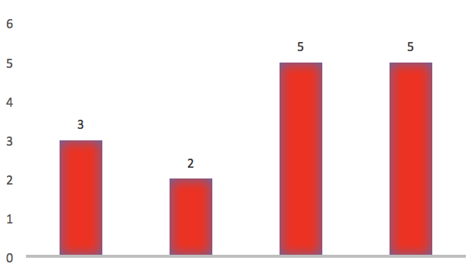
Future Directions: optogenetics with micromirror arrays (cont’d)
micromirror array
ChR2⁺
G-CaMP⁺
G-CaMP fluorescence
ChR2⁺
AU
neuron1
neuron2
combined
light source
Arithmetic sum

Slide 14
Acknowledgements
Gordus Lab
Andrew Gordus
Xiaoyi Li
Jeremiah Miller
Anastasia Miller
Ariel Parker
Elana Pyfrom
Nick Wilkerson
Emmons Lab: in silico data

Slide 15
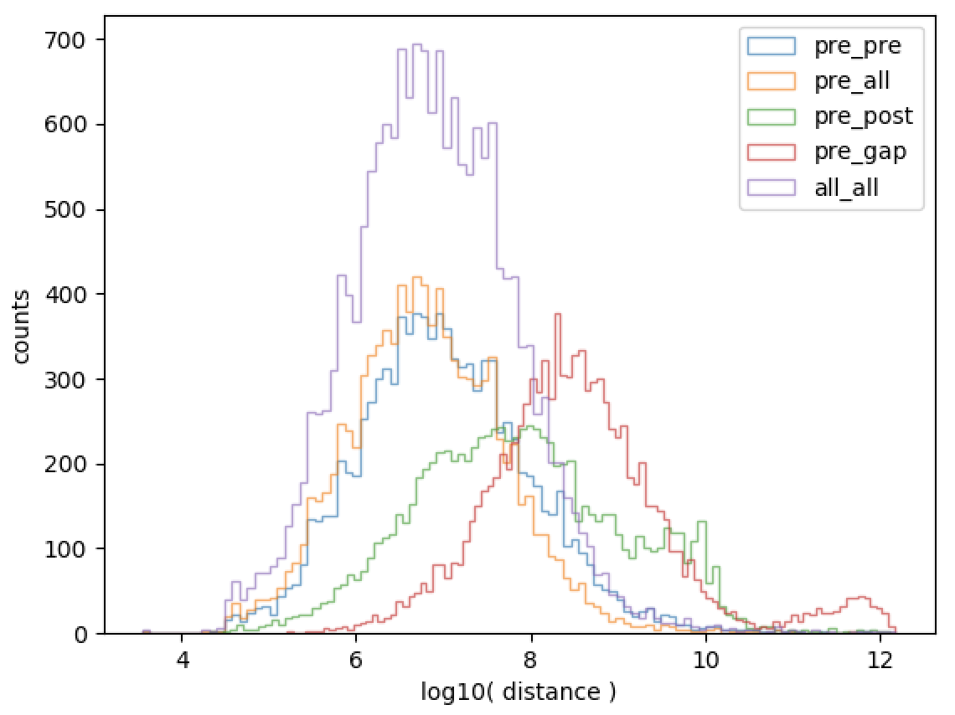
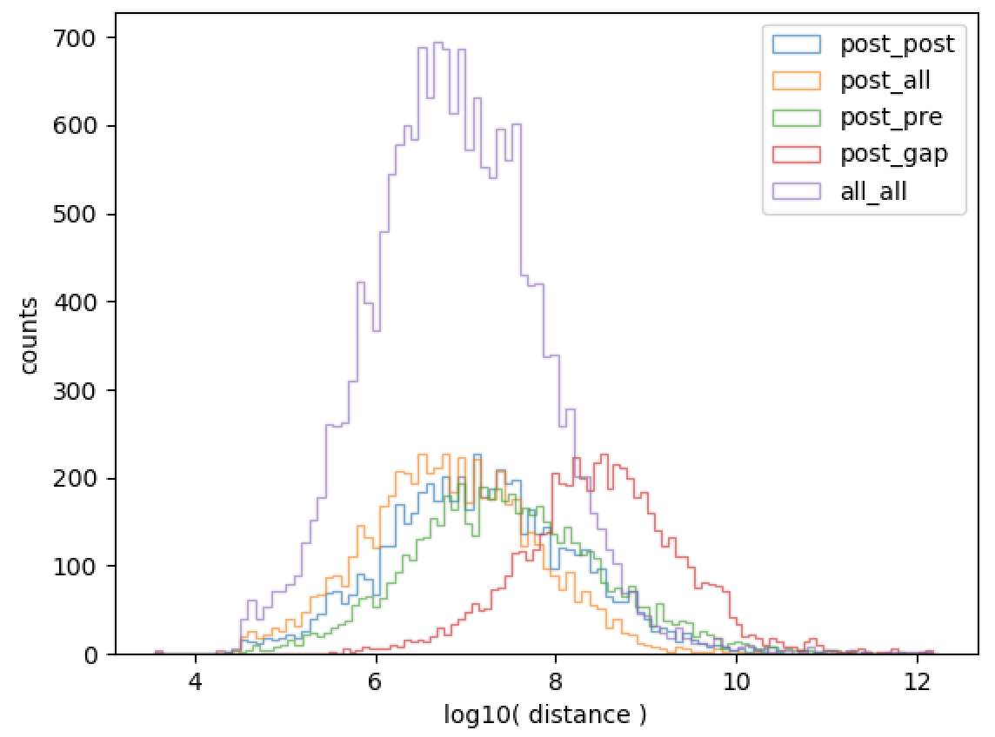
Distance distribution between synapses and their nearest neighbor
count
count
log₁₀( distance )
log₁₀( distance )

